Slide 1
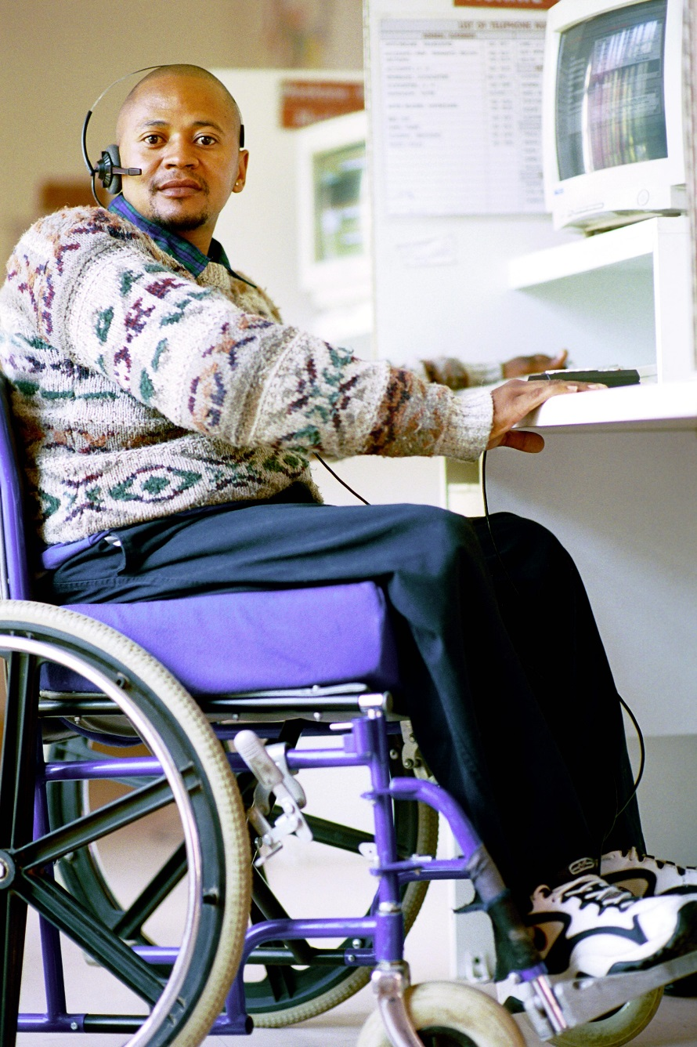
Chapter 5: SDG 9.c
INCREASING ACCESS TO ICTs
Deepti S. Raja, The World Bank
On behalf of Task Team on SDG 9.c
Photo Credit: Trevor Samson / World Bank

Slide 2

Task Team Members
Martin Gould, G3ICT
Stuart Hamilton, Independent Expert
Derrick L. Cogburn, Institute of Disability and Public Policy, American University (Coordinator)
Nancy Bolt, International Federation of Library Associations
Stephen Wyber, International Federation of Library Associations
Jose Maria Batanero, ITU
Heidi Ullmann, UN ECLAC
Irmgarda Kasinskaite-Buddeberg, UNESCO
Florence Migeon, UNESCO
Deepti Samant Raja, The World Bank (Coordinator)

Slide 3

What did we do?
Collating research reports and publications authored or recommended by task team members
Original research conducted by some members such as UN ECLAC, IFLA
UNESCO commissioned a detailed desk review
Over 50 references

Slide 4

The mandate
SDG 9: Industry, Innovation and Infrastructure
Reference to Internet access represents a crucial factor in the development of digital inclusion
Target 9.C: Significantly increase access to information and communications technology and strive to provide universal and affordable access to the Internet in least developed countries by 2020
Main issues:
Broadband to get to the Internet/web
Access to technology
Adaptations to the technology depending on the specific disability and needs
Training in use and application where needed

Slide 5
Discussion Questions
Cross-linkages across chapters – this chapter stays focused on 9c with some but not extensive references to how ICT plays a role in education, employment, independent living etc.
Level of detail, data and coverage of issues
General v. specific recommendations
Other comments and observations

Slide 6
INTRODUCTION

Slide 7
Framing the topic of digital inclusion
“For most people, technology makes things easier. For persons with disabilities, technology makes things possible.”
Mary Pat Radabaugh, former Director of the IBM National Support Centre for Persons with Disabilities
Increasing potential for ICT to be an equalizer
ICT increasingly used for service delivery, access to information
Mainstream ICTs are increasingly accessible with a range of assistive features
Access to internet seen as human right

Slide 8
Value of inclusive ICTs for participation
Rankings by 150 experts from 55 countries for the importance of different ICTs for inclusion (UNESCO et al., 2013). Scale: 5 = Most important,1 = Least important.
 | Websites | Mobiles | TV sets | Radio | Other
Healthcare | 3.3* | 3.1 | 2.9 | 2.5 | 2.7
Primary education | 3.0* | 2.6 | 2.8 | 2.3 | 2.9
Secondary education | 3.4* | 3.0 | 2.7 | 2.3 | 2.8
Tertiary, prof., lifelong education | 3.7* | 3.4 | 2.9 | 2.4 | 2.8
Employment | 3.7* | 3.3 | 2.5 | 2.2 | 2.7
Independent living | 3.4 | 4.6* | 2.8 | 2.4 | 2.8
Government services | 3.5* | 3.0 | 3.0 | 2.3 | 2.6
Participation: Political/public life | 3.3* | 3.1 | 2.7 | 2.5 | 2.6
Websites and mobile devices and services can contribute most to inclusion
Highest impact on independent living, employment, education, and access to government services

Slide 9
INTERNATIONAL NORMATIVE FRAMEWORK

Slide 10
Convention on the Rights of Persons with Disabilities
Accessibility is a core principle; 7 articles with Accessibility Dispositions with implications for ICTs (G3ict ICT Progress Report 2016)
Article 9: ensure access to information and communications technologies and systems; technology design should take into account accessibility and usability
Article 21: access to information
Article 24: access to technology to support or assist learning
Article 26: promote the availability, knowledge and use of assistive devices and technologies

Slide 11


Sustainable Development Goals
SDG 9: Industry, Innovation and Infrastructure
Reference to Internet access represents a crucial factor in the development of digital inclusion
Target 9.C: Significantly increase access to information and communications technology and strive to provide universal and affordable access to the Internet in least developed countries by 2020
SDG 16: Peace, Justice and Strong Institutions
Reference to e-government services, electoral processes, access to information
SDG 17: Partnerships for the goals
Collaborative development of technology, technology transfer, capacity building

Slide 12
Other global and regional treaties
WSIS+10 Review and Strategic Directions for Building Inclusive Knowledge Societies for Persons with Disabilities
Article 12 of the International Telecommunication Regulations
Tunis Commitment of 2005
European Union Digital Agenda (2010)
European Accessibility Act (2016)
New Urban Agenda (2016)
2013 Marrakesh VIP Treaty

Slide 13
SITUATION OF PERSONS WITH DISABILITIES

Slide 14
Disability and the Digital Divide
Lack of globally comparable data on Internet access/usage by persons with disabilities
Overall, ICT data shows a divide between developed and developing regions, as well as a gender divide
Recent study in Great Britain found that persons with disabilities were more than 20% less likely to have ever used the internet than those without a disability (UK Office for National Statistics, 2013)
Global data shows that mobile cellular networks and 3G coverage are increasing in demand over fixed broadband networks

Slide 15
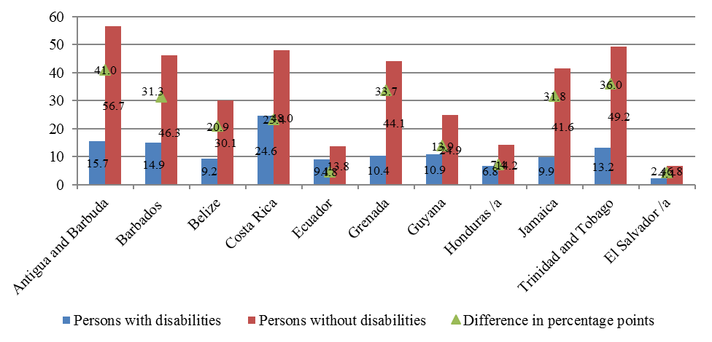
Latin America and the Caribbean (11 countries): use of internet by disability status, around 2010
(In percentages)
Source: Ullmann, Jones, Williams and Williams (ECLAC), forthcoming 2018. Do not copy or reproduce without author permission.

Slide 16
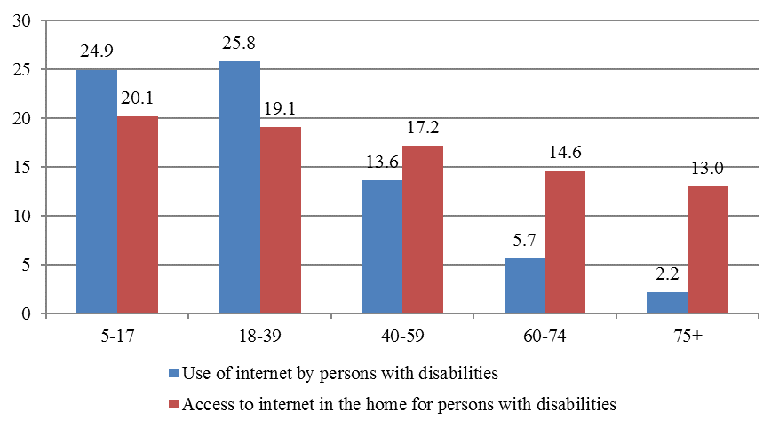
Latin America and the Caribbean (11 countries): use of and access to the internet by persons with disability by age, around 2010
Source: Ullmann, Jones, Williams and Williams (ECLAC), forthcoming 2018. Do not copy or reproduce without author permission.

Slide 17
Meeting CRPD ICT Obligations
G3ict & DPI 2016 ICT Accessibility Progress Report
Overall Degree of Compliance with CRPD ICT Accessibility Provisions
Survey Data Clusters | All countries | Countries in the Global South
Leg 1 - Countries' Commitments | 42% | 33%
Leg 2 - Countries' Capacity for Implementation | 21% | 18%
Leg 3 - Countries' Implementation and Impact | 41% | 35%
Degree of Compliance of Country Legislations and Policies with CRPD ICT Accessibility Provisions
 | General Regulatory Framework | Policies Covering Specific Application Areas | Policies Covering Accessibility for Specific ICT Products or Services | Policies Covering Specific Target Groups | Policies to Promote Accessible and Assistive ICTs
All countries | 69% | 45% | 27% | 17% | 16%
Countries in the Global South | 57% | 34% | 21% | 15% | 11%

Slide 18
Meeting CRPD ICT Obligations
G3ict & DPI 2016 ICT Accessibility Progress Report
Degree of Country Capacity to Implement CRPD ICT Accessibility Provisions
 | Government Focus | Support of DPOs and NGOs | Capacity building
All countries | 35% | 10% | 22%
Countries in the Global South | 31% | 8% | 18%
Degree of Implementation CRPD ICT Accessibility Provisions and Impact
 | Telecom and Media Services and Computers | Mobile | Special Services
All countries | 41% | 45% | 33%
Countries in the Global South | 36% | 41% | 24%

Slide 19
2016 United Nations E-Government Survey
Shows positive trend towards investments and efforts by countries to ensure outreach of online services to different marginalized groups
Significant jumps in the number of countries that have invested in targeted efforts to reach out to youth, women, and immigrants.
However, while there have been increases from the last survey, only 13 countries introduced services between 2014 and 2016 for older persons and persons with disabilities.
As a result, the total number of countries offering such service is less than one-third of all countries (193)

Slide 20
GOOD PRACTICES AND POLICY TRENDS

Slide 21
Policy Trends
Public Procurement & Accessibility Standards
Inclusion of accessibility requirements in public procurement of ICT/electronic equipment is an important policy tool
Tie procurement requirements to accessibility standards and guidelines for accessible websites, documents, other digital media
Section 508 in the US and Europe’s EN 301 549 are the main models
The implementation of Section 508 led to “greater innovation, competition, and choice for accessible technology in the marketplace” (G3ict 2015)
Web Content Accessibility Guidelines 2.0; ISO accessibility standards for a variety of ICTs such as keyboards & screens, software, PDF documents; digital publishing guidelines; and standards for closed captioning and digital video broadcasting

Slide 22
Policy Trends
National level policies and programs
Trends from G3ict & DPI 2016 ICT Accessibility Report
Captioning or signing of television programs implemented by 50% of the countries;
Relay services for deaf and speech impaired users (implemented by 23% of the countries);
Implementation of computer-based Assistive Technologies in schools and universities (31% of the countries have some level of implementation);
A government body dedicated to ICTs (implemented by 54% of the countries); and
Libraries for the blind or public libraries with e-book services (implemented by 36% of the countries).

Slide 23
Meeting CRPD ICT Obligations
Laws, regulations and policies enacted by States Parties by Level of Implementation - Does the Country: | No Implementation | Minimum Level | Partial Level | Substantial Level | Full Level
Ensure that government communications to the public using ICTs are provided in accessible formats, sign language or Braille? | 53% | 32% | 12% | 2% | 0%
Define public procurement rules policy promoting accessible ICTs? | 69% | 20% | 8% | 2% | 0%
Have policies for ATs and Services by Type of Disability: Blind? | 32% | 40% | 17% | 10% | 0%
Have policies for ATs and services by Type of Disability: Visually Impaired? | 31% | 40% | 19% | 8% | 1%
Have policies for ATs and Services by Type of Disability: Deaf? | 31% | 38% | 20% | 11% | 0%
Have policies for ATs and Services by Type of Disability: Hearing Impaired? | 32% | 38% | 21% | 10% | 0%
Have policies for ATs and Services by Type of Disability: Reduced Mobility? | 33% | 28% | 27% | 10% | 1%
Have policies for ATs and Services by Type of Disability: Cognitive? | 42% | 42% | 15% | 0% | 1%
Have laws, policies or programs to ensure that PwD and their representative organizations are consulted in development and implementation of legislation? | 34% | 41% | 16% | 7% | 2%
Source: 2016 ICT Accessibility Progress Report

Slide 24
Meeting CRPD ICT Obligations
Specific Application Areas by Level of Implementation | No | Minimum | Partial | Substantial | Full
Emergency Response Services | 66% | 22% | 7% | 3% | 2%
Primary and Secondary Education | 51% | 13% | 30% | 5% | 1%
Higher Education | 58% | 18% | 17% | 6% | 1%
Rehabilitation Services | 54% | 20% | 21% | 4% | 1%
Health Services | 65% | 20% | 14% | 1% | 0%
Electronic Kiosks | 82% | 13% | 4% | 0% | 1%
Judicial Information and Legal Procedure | 71% | 18% | 10% | 1% | 0%
Independent Living | 65% | 19% | 13% | 2% | 1%
Reasonable Accommodation at Workplace | 58% | 25% | 10% | 7% | 0%
Teleworking | 86% | 14% | 0% | 0% | 0%
Smart Cities | 80% | 20% | 0% | 0% | 0%
Source: 2016 ICT Accessibility Progress Report

Slide 25
Practice Trends
Universal Design and built-in accessibility in mainstream ICT
Internet based assistive technologies
Specialized assistive technologies
Accessible and assistive mobile apps
Webtools and online platforms
Potential for inclusive home and external environments through Internet of Things
Accessible television and radio

Slide 26
UN ACTIVITIES

Slide 27
UN Activities
WHO
UNESCO
UNICEF
ITU
ILO
World Bank

Slide 28
RECOMMENDATIONS AND CONCLUSION

Slide 29
Recommendations
Take an ecosystem approach to promoting accessible and inclusive ICTs
Promote the visibility and understanding of disability
Raise awareness and knowledge of ICT accessibility
Build capacity of governments, practitioners, technology developers, designers, educators, librarians, others
Involve persons with disabilities directly
Collect/publish comparable data at the national level
Improve the legislative and regulatory framework

Slide 30
Recommendations
Provide affordable Internet access for persons with disabilities
Reduce cost and access barriers for mobile and assistive technologies
Promote indigenous, local language ICT solutions
Promote the principles of Universal Design in the mainstream ICT industry and the public sector
Provide funding mechanisms to support the development of open-source software
Promote ICT-based vocational training and higher education of persons with disabilities
Create dedicated national government departments/focal points for ICT Accessibility
Create an international pool of experts in the field of ICT accessibility

Slide 31
Conclusion
To maximize the social and economic dividends of digital technologies we have to pay attention to the “analog complements” such as policy and regulations, skills and capacity, and institutional accountability (The World Bank, 2016)
Digital technologies present an unprecedented opportunity for inclusion; but also a risk of further exclusion and disenfranchisement
Implementation of recommendations needs the involvement of multiple stakeholders
Availability, affordability, and access to inclusive ICTs is key
There is a need for increased funding and investment
Mainstream accessibility and inclusion in general ICT for development projects

Slide 32
Discussion Questions
Cross-linkages across chapters – this chapter stays focused on 9c with some but not extensive references to how ICT plays a role in education, employment, independent living etc.
Level of detail, data and coverage of issues
General v. specific recommendations
Other comments and observations

Slide 33
Reach out to us
Deepti Raja
draja@worldbank.org
Derrick Cogburn
dcogburn@idppglobal.org

